Slide 1
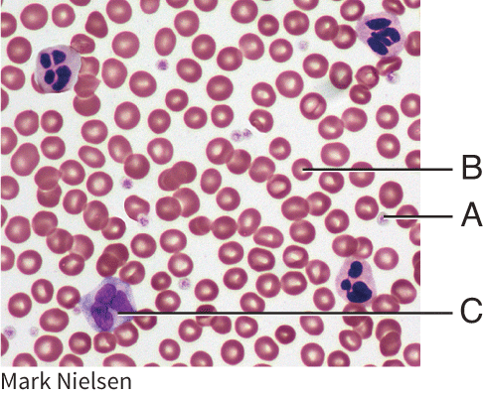
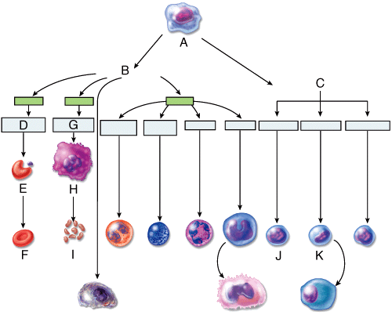

Slide 2
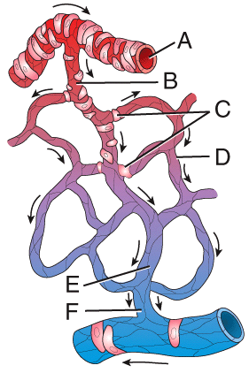
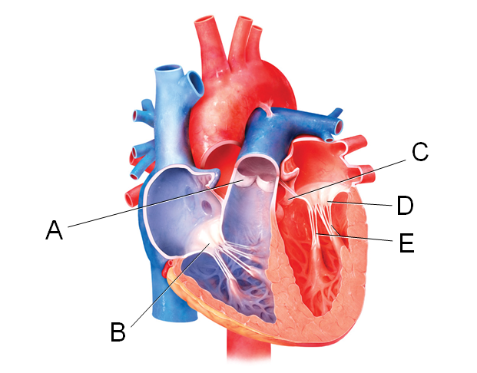

Slide 3
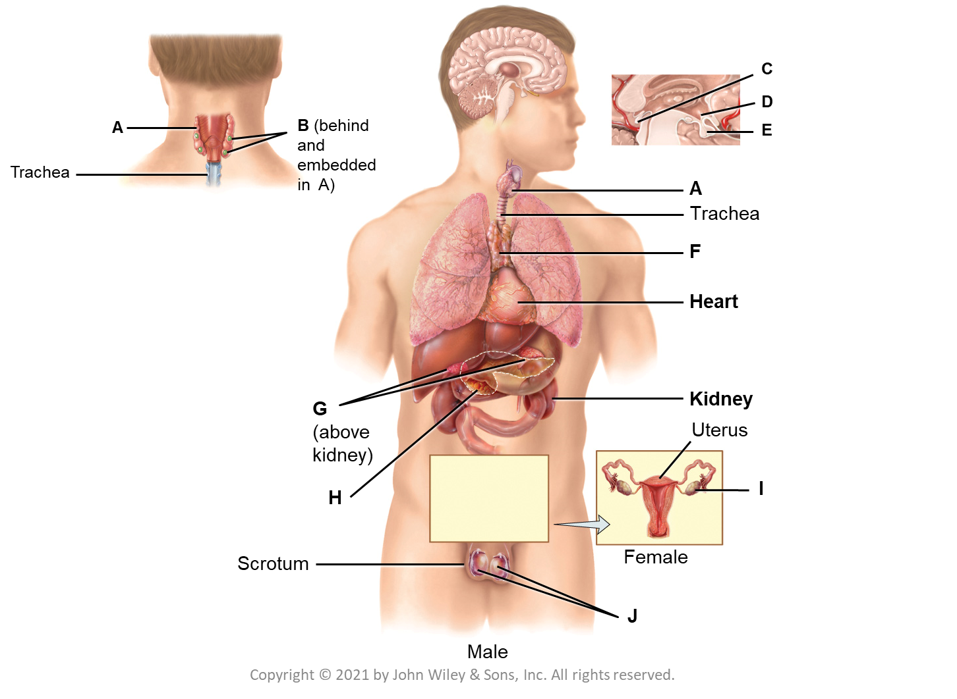
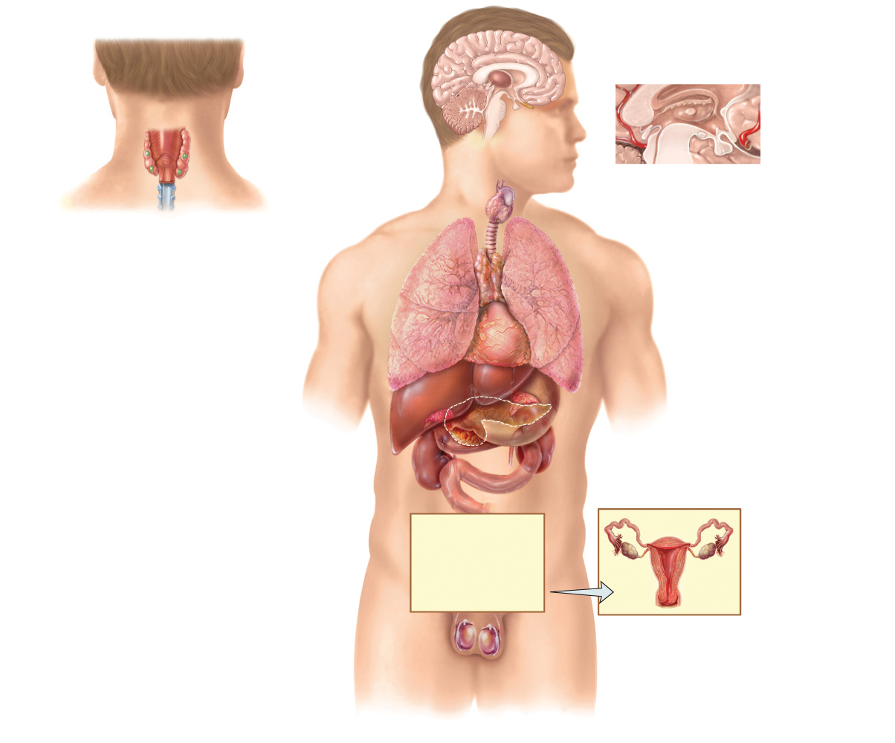
C
D
A
B (behind and embedded in A)
E
Trachea
A
Trachea
F
Heart
G
(above kidney)
Kidney
Uterus
H
I
Scrotum
Female
J
Male

Slide 4
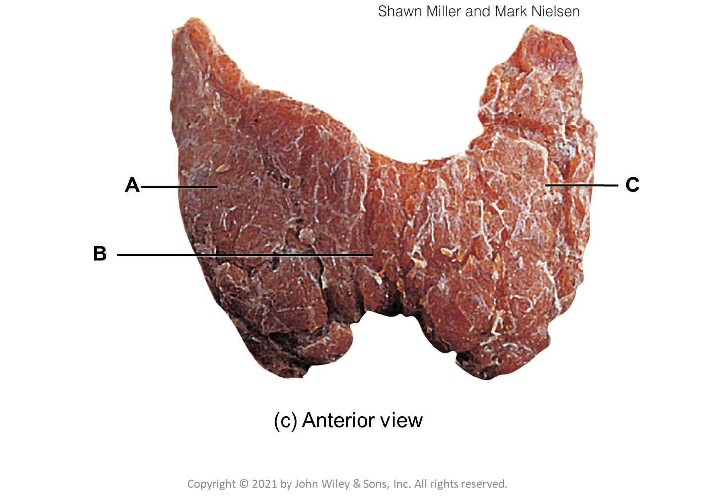
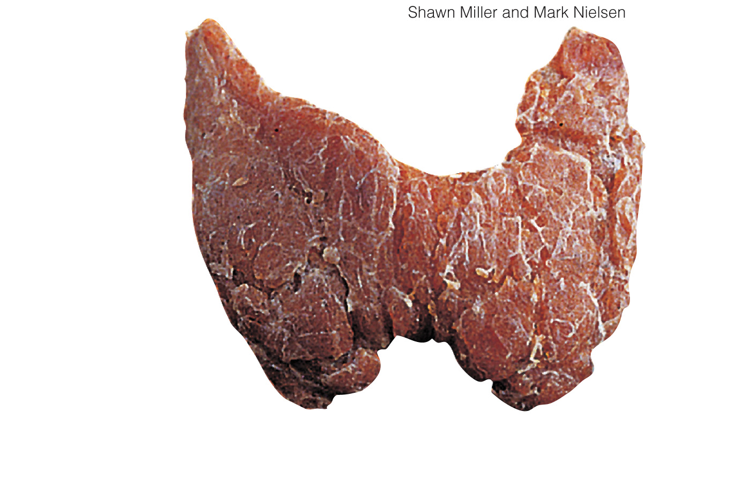
A
C
B
(c) Anterior view

Slide 5
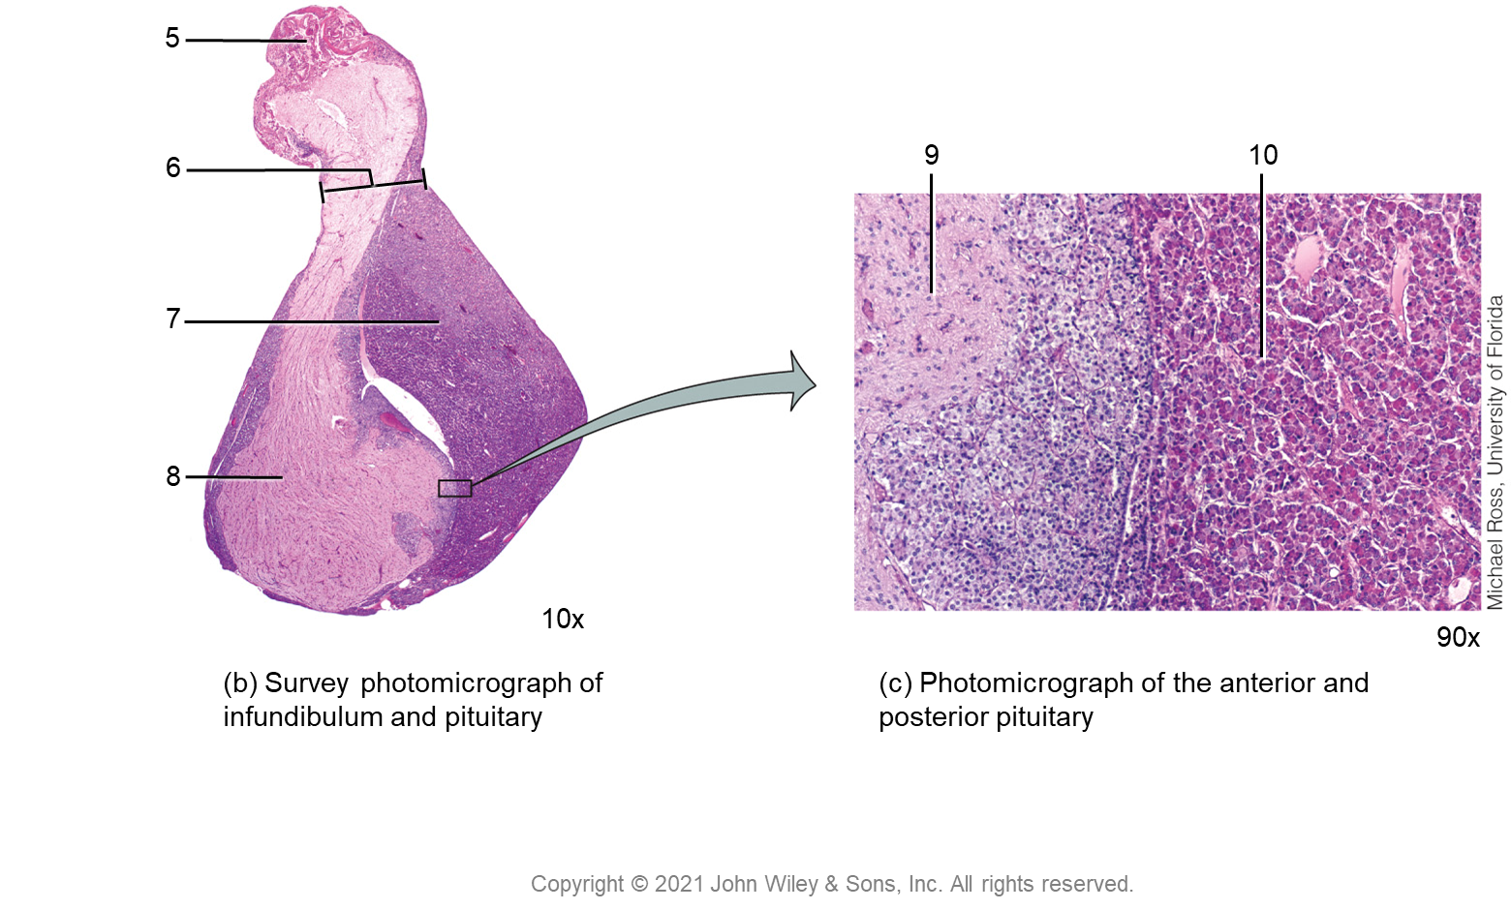
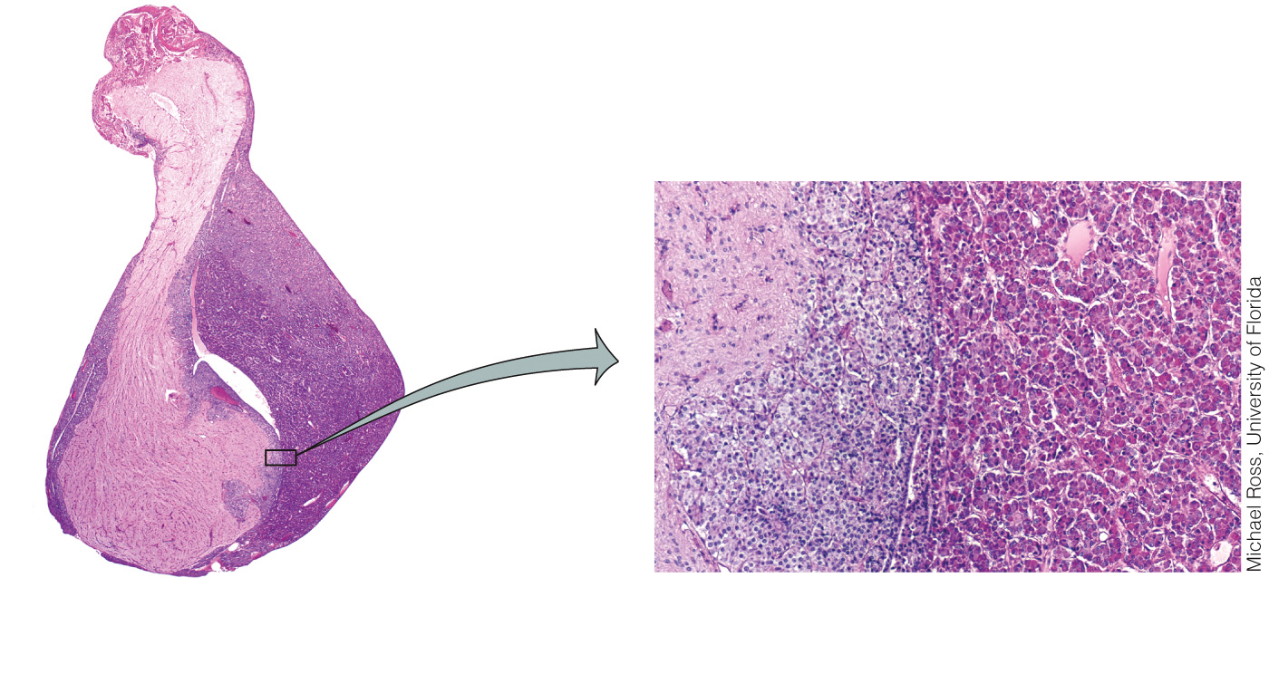
5
6
9
10
7
8
10x
90x
(b) Survey photomicrograph of infundibulum and pituitary
(c) Photomicrograph of the anterior and posterior pituitary
Copyright © 2021 John Wiley & Sons, Inc. All rights reserved.

Slide 6
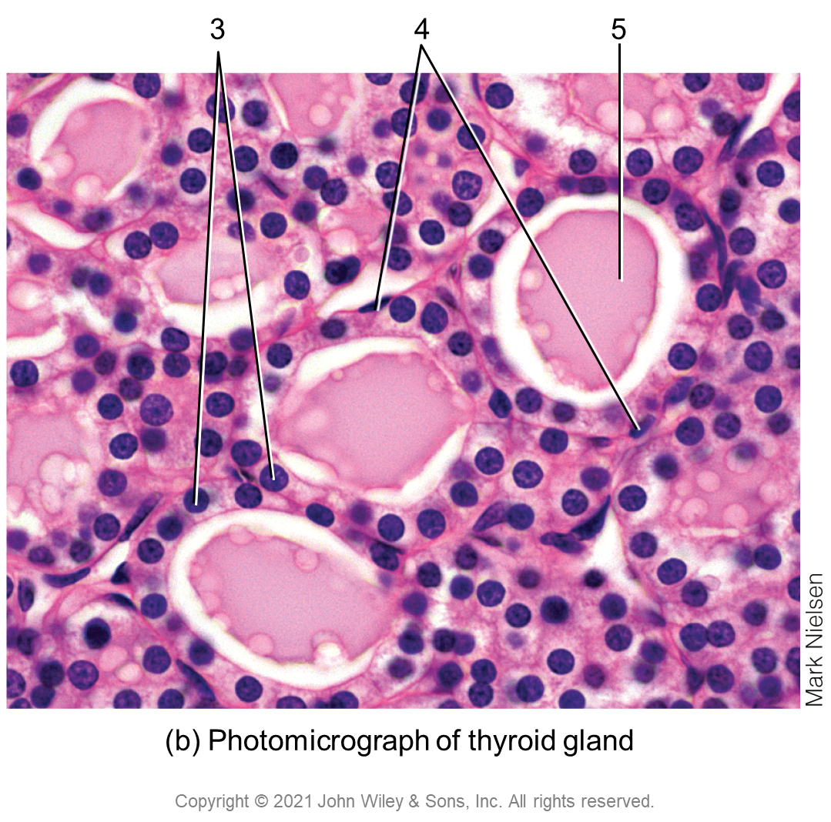
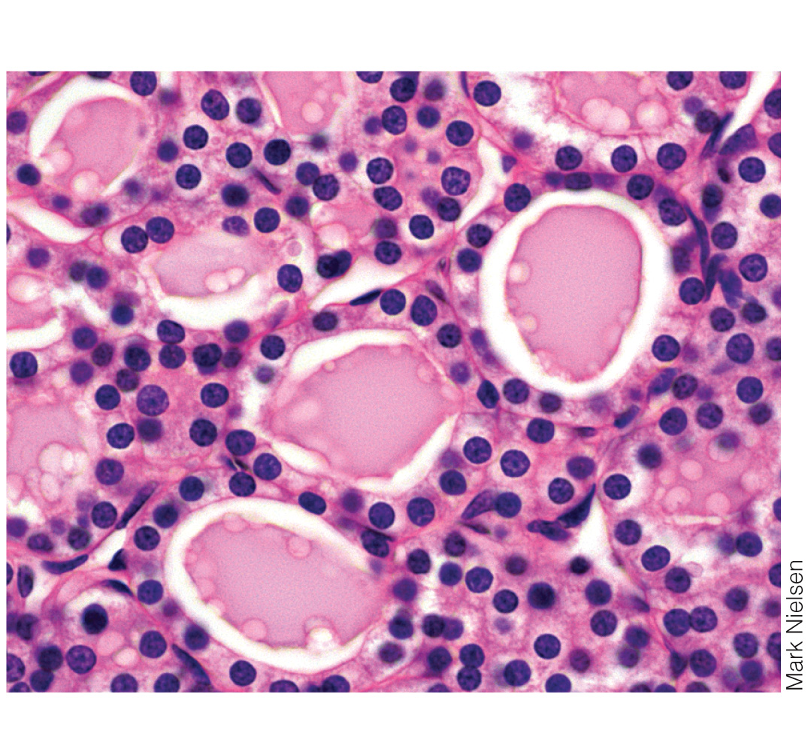
3
4
5
(b) Photomicrograph of thyroid gland
Copyright © 2021 John Wiley & Sons, Inc. All rights reserved.

